Slide 1
PLACEMENT YEAR AT Stoyanov Kristiyan

Slide 2
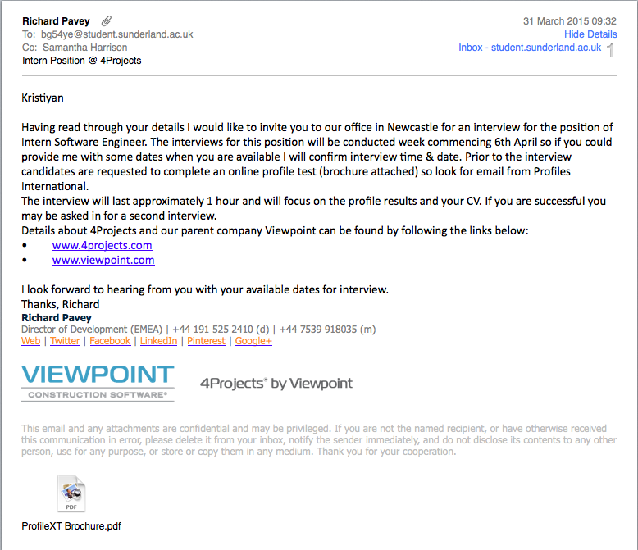
Application procedure

Slide 3
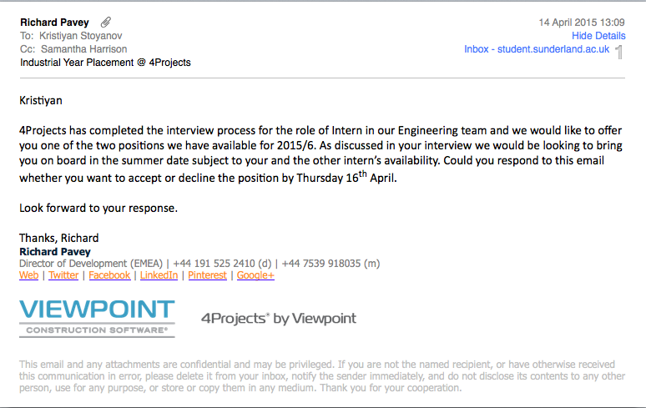
Application procedure

Slide 4
OVERVIEW
Introduction
Company culture
Personal role & work carried out
Achievements
How did it look like

Slide 5
Introduction
Brief history of Viewpoint Construction Software
VfP – Viewpoint for Projects
VF – Viewpoint Field View
Headquarters - EMEA, Oregon,

Slide 6
Company culture
SaaS - Business oriented
Agile/Kanban Software Development
Casual dress code
Friendly people
Various type of refreshments on site, pizza days, cake fridays etc.

Slide 7
Personal role & work carried out
Software Engineering & Development
Worked on internal project Customer Support Dashboard
Fixed several bugs on core product (VfP)
Found several bugs before release

Slide 8

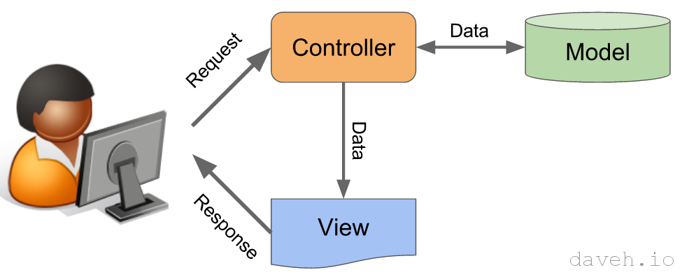
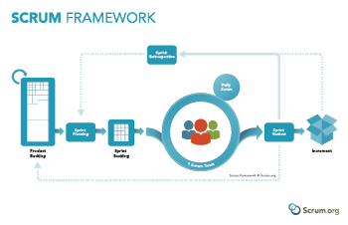

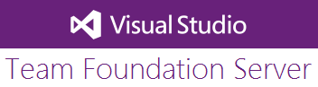
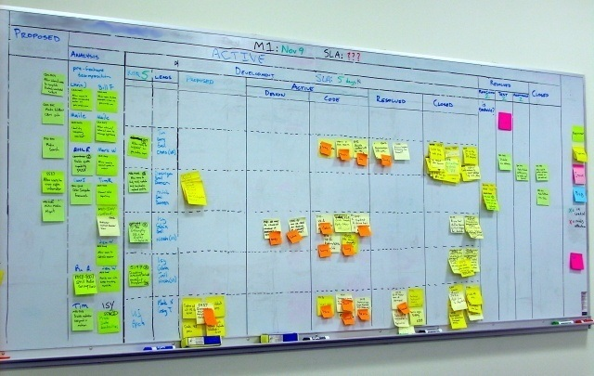
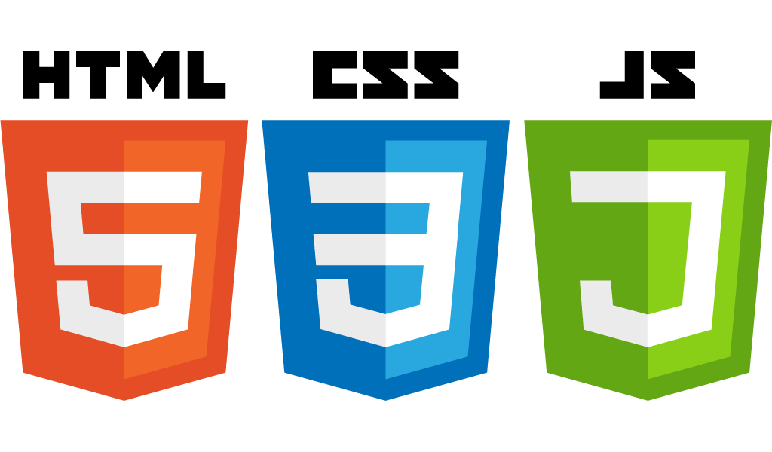

Tools and technologies used

Slide 9

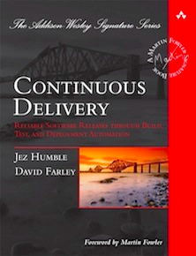



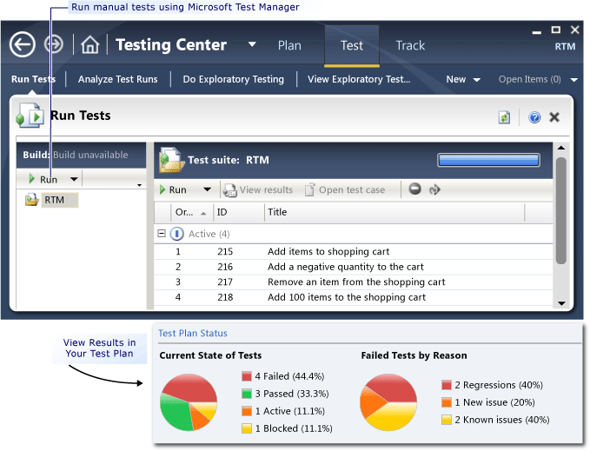

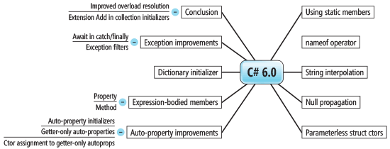

Tools and technologies used

Slide 10
achievements
Enjoyed it a lot
Chance to see the “Real world”
Improved programming, analytical thinking, teamwork
Experience to work across the organisation
Exposure to QA, Support, Engineering, DevOps
Established good friendships

Slide 11
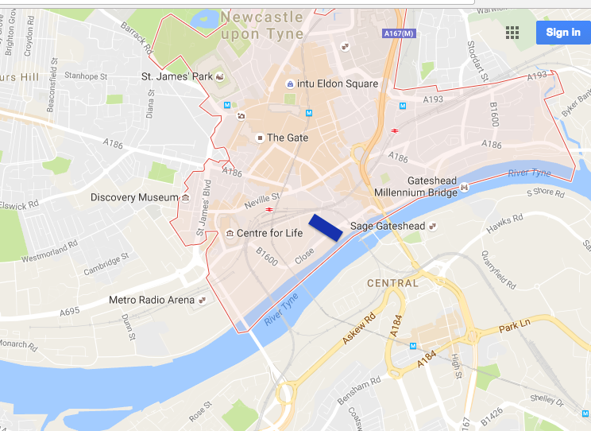
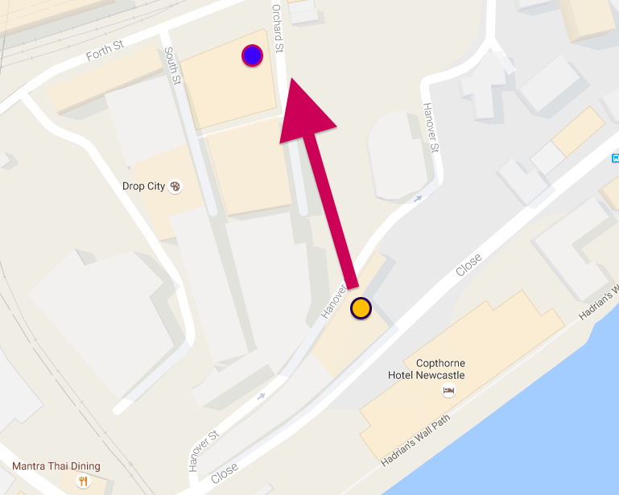
How it looked like from pictures

Slide 12
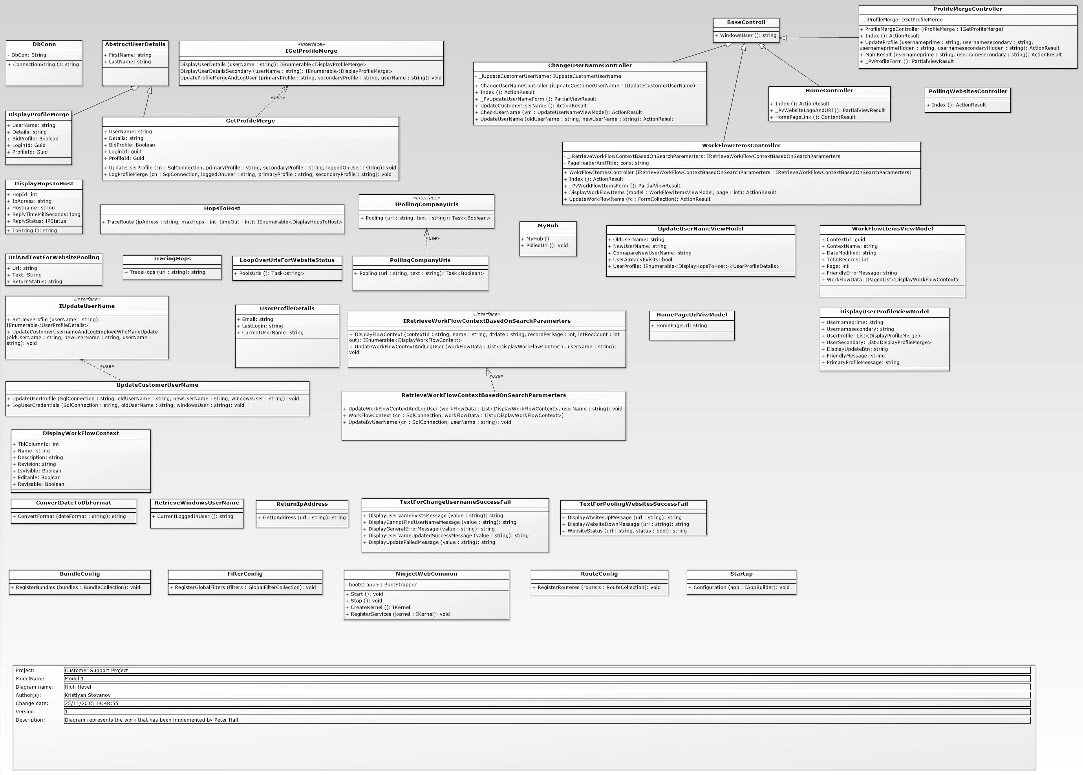
Customer support portal

Slide 13
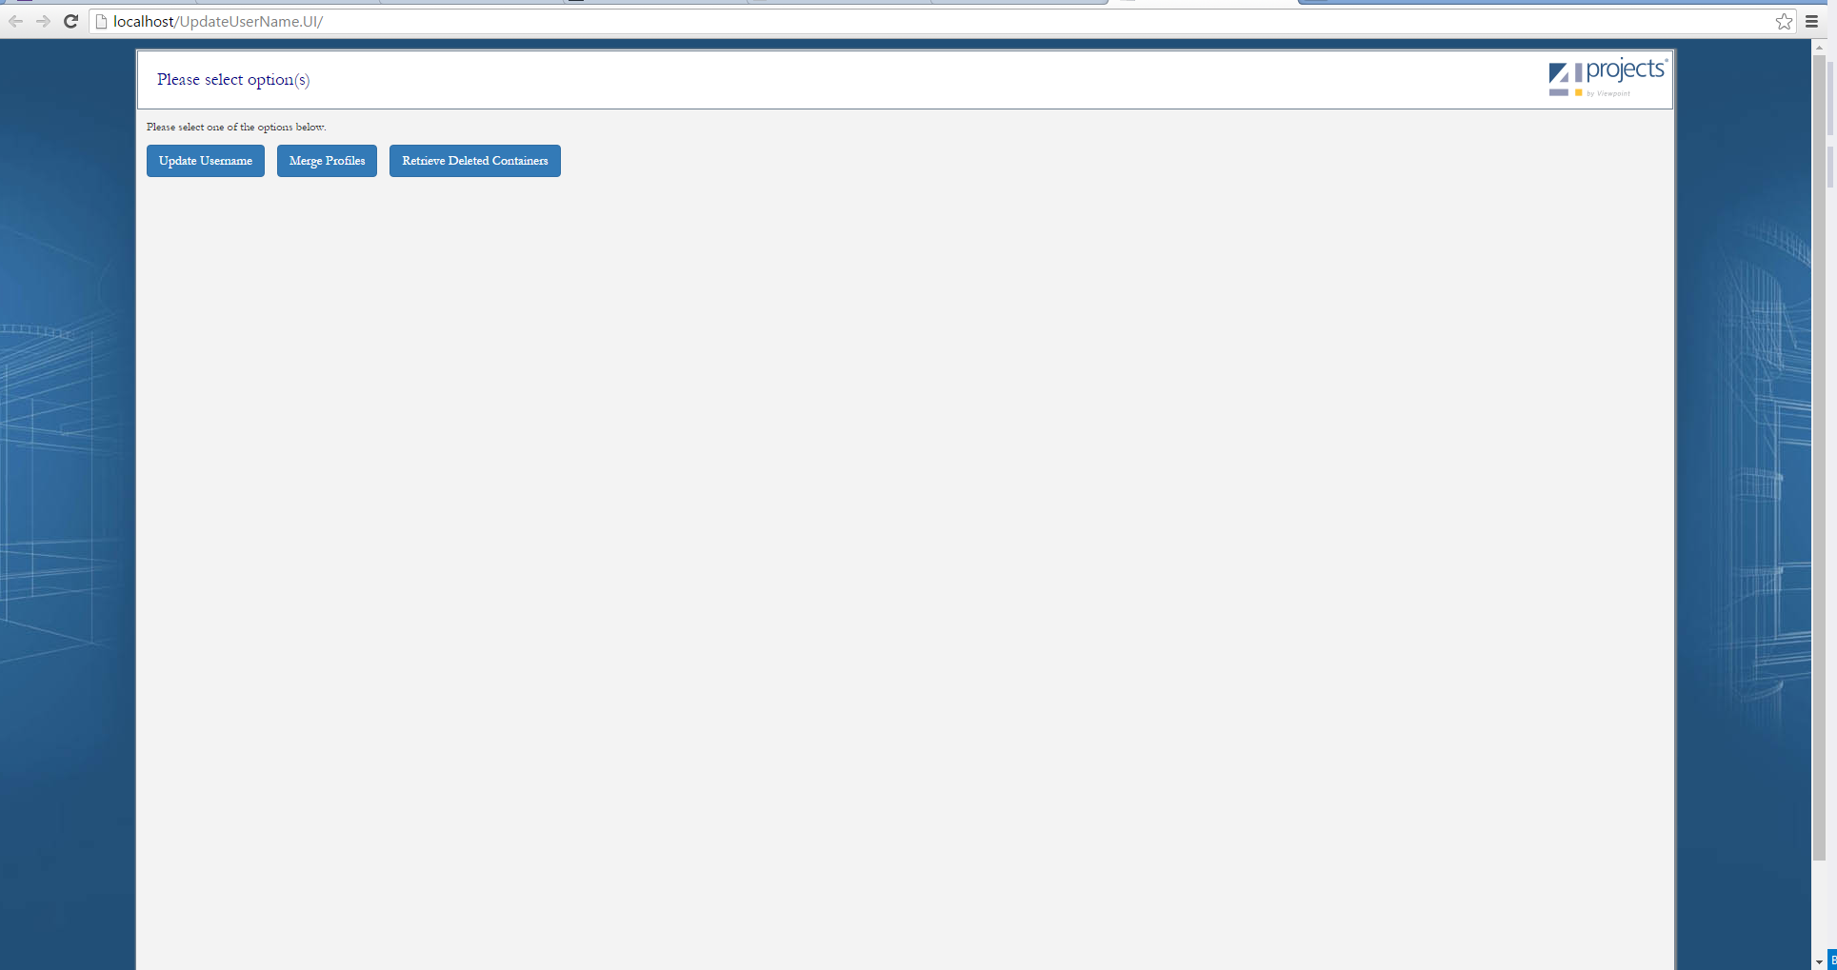
OLD User interface on home page

Slide 14
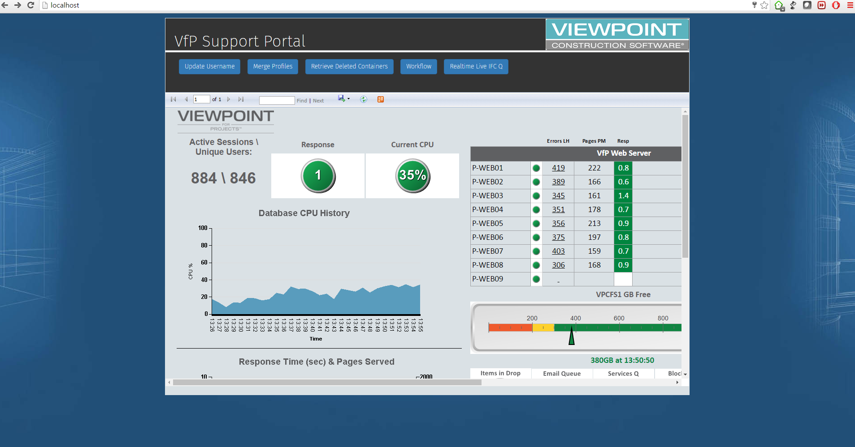
New user interface home page

Slide 15
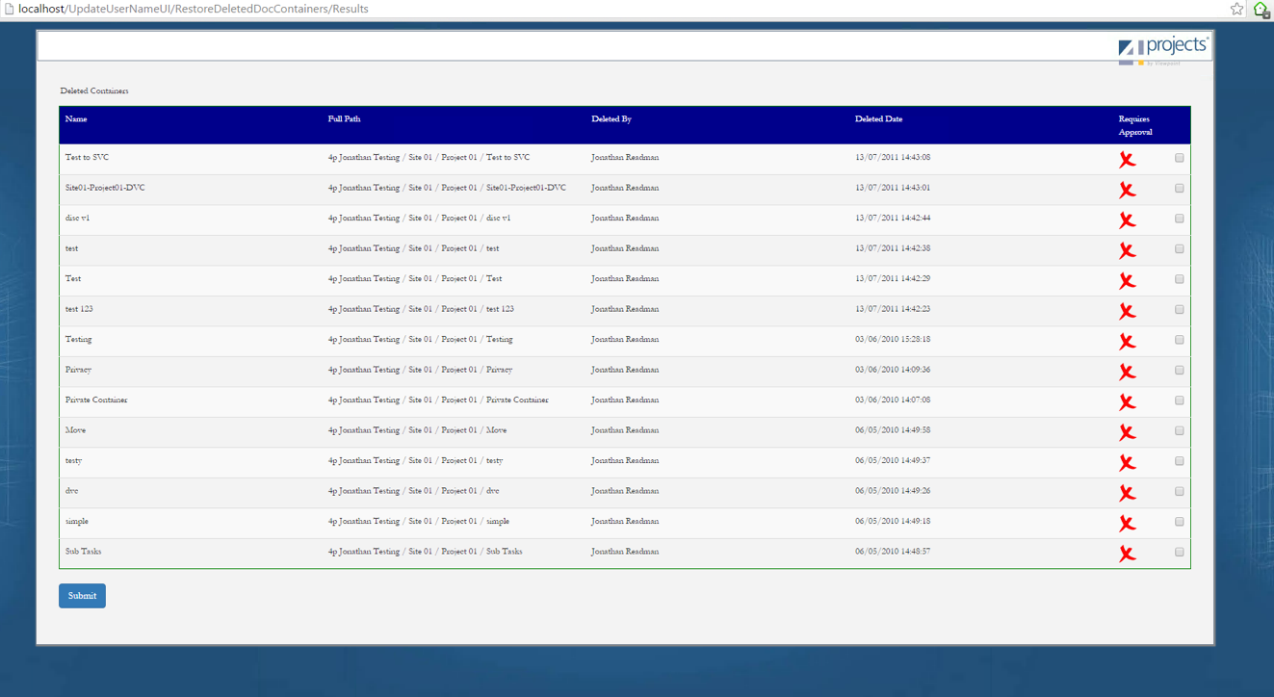
OLD USER INTERFACE – CONTAINER TABLE

Slide 16
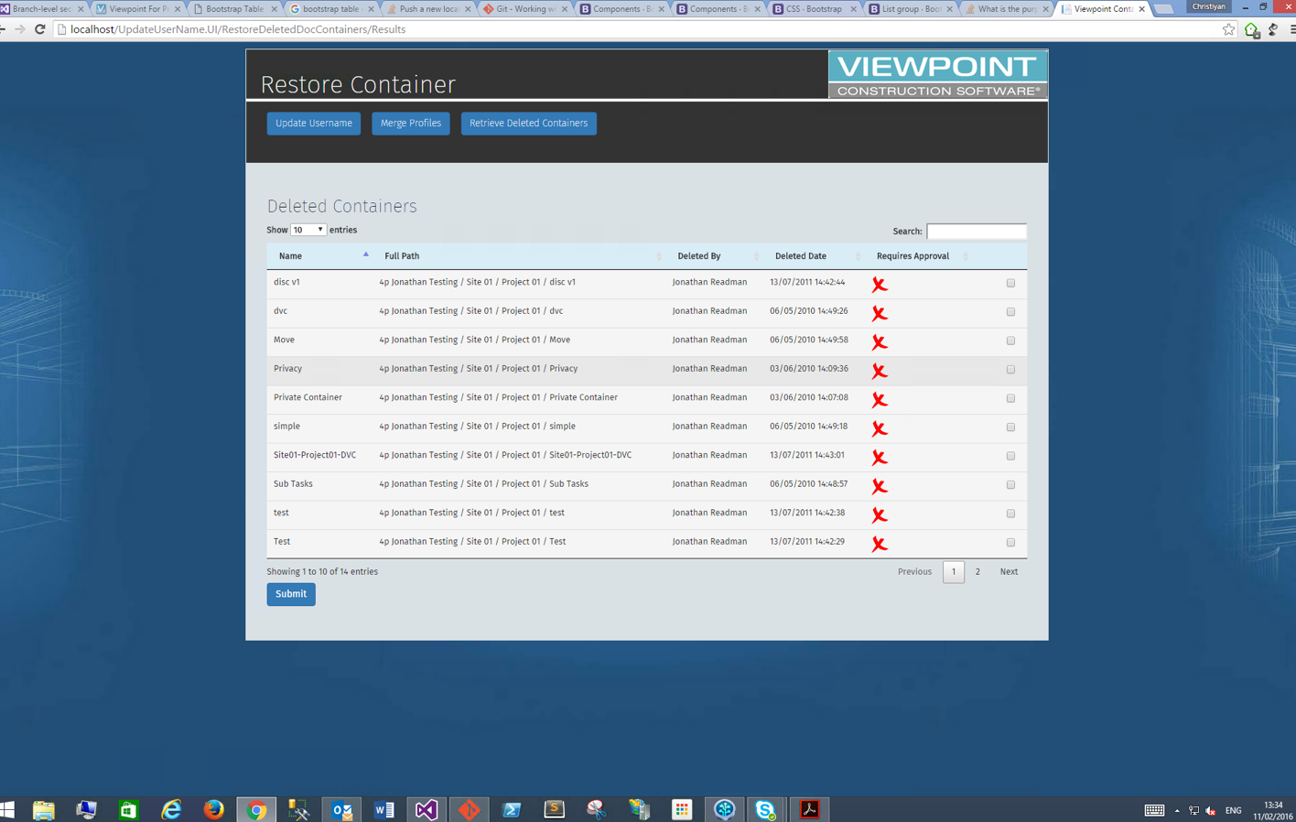
updated user interface – container results

Slide 17
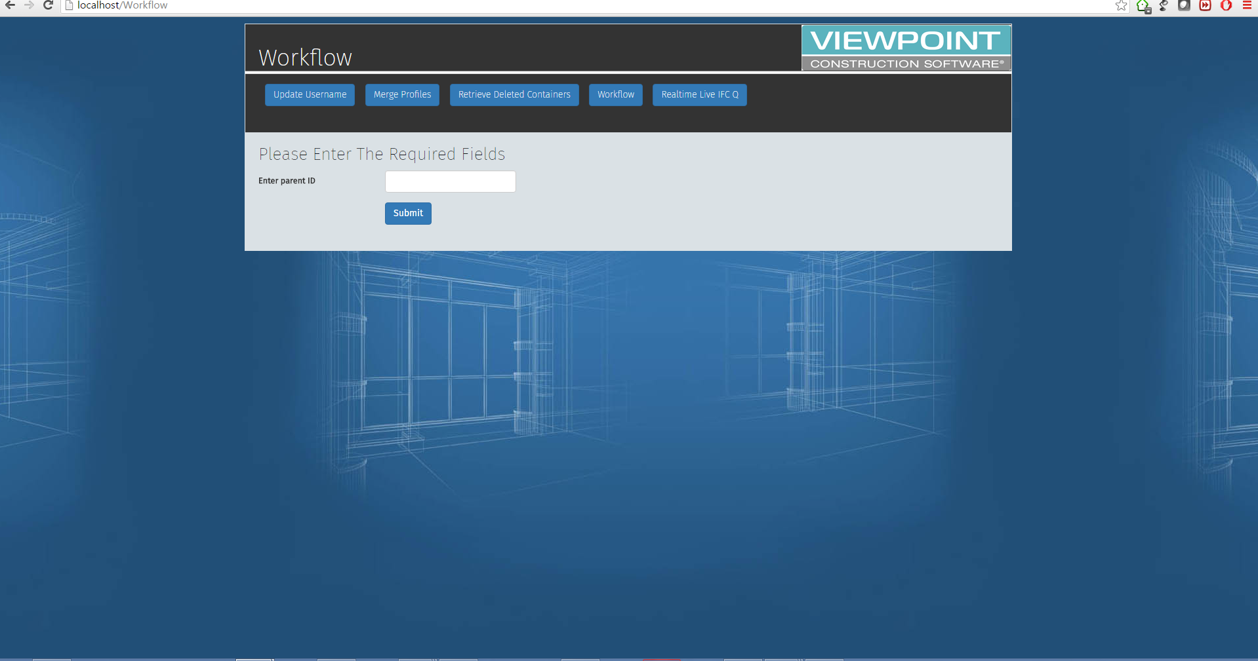
wORKFLOW FUNCTIONALITY

Slide 18
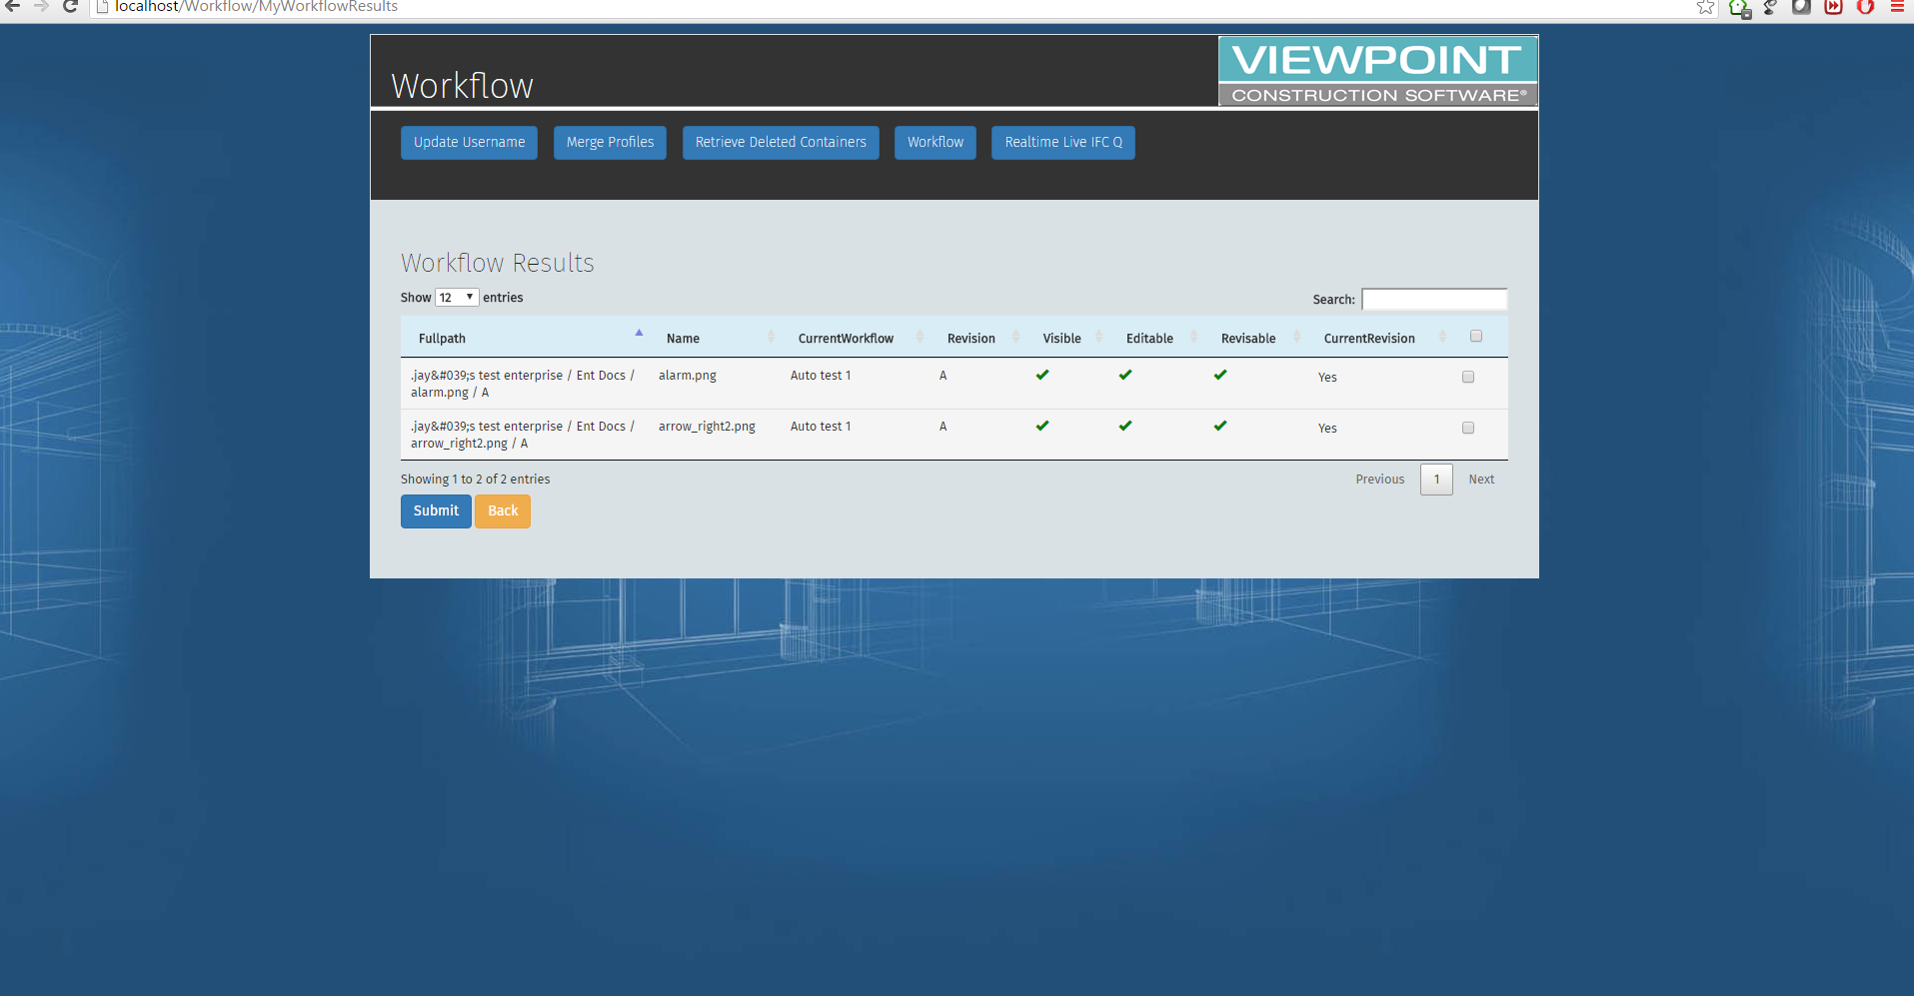
wORKFLOW FUNCTIONALITY

Slide 19
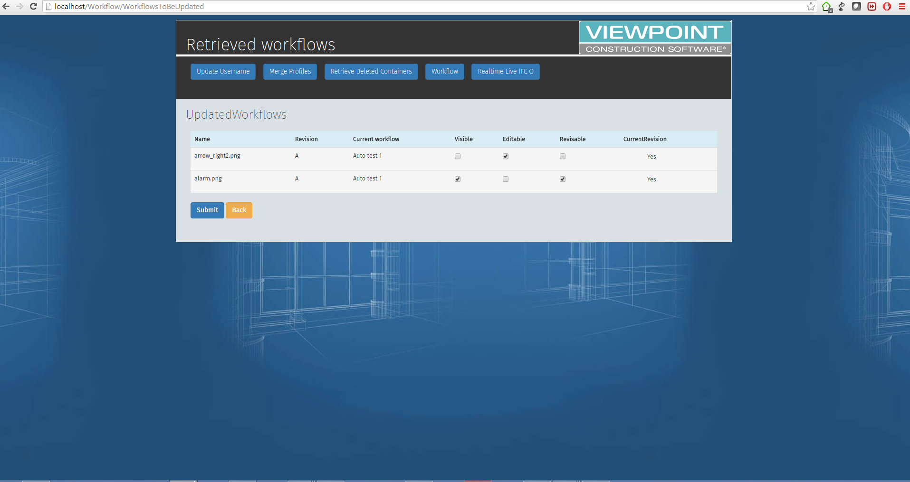
wORKFLOW FUNCTIONALITY

Slide 20
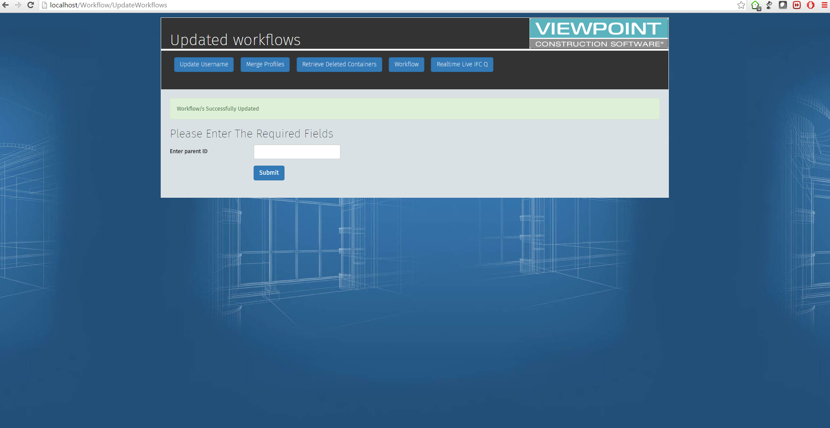
wORKFLOW FUNCTIONALITY

Slide 21

wORKFLOW FUNCTIONALITY

Slide 22
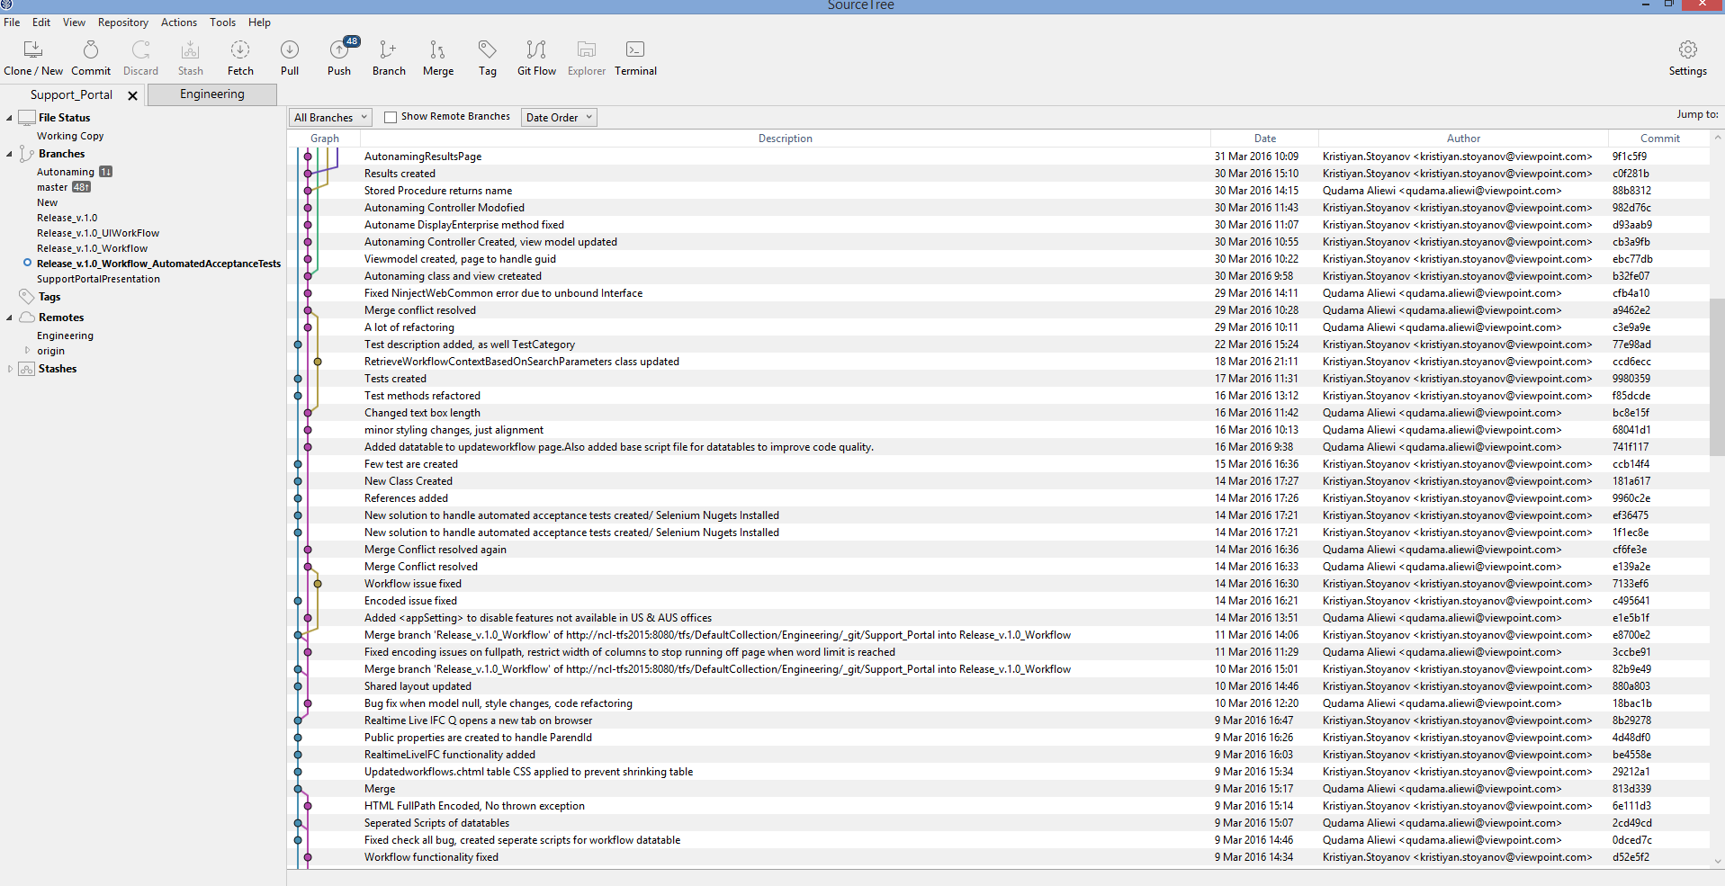
Svcs – my own project

Slide 23
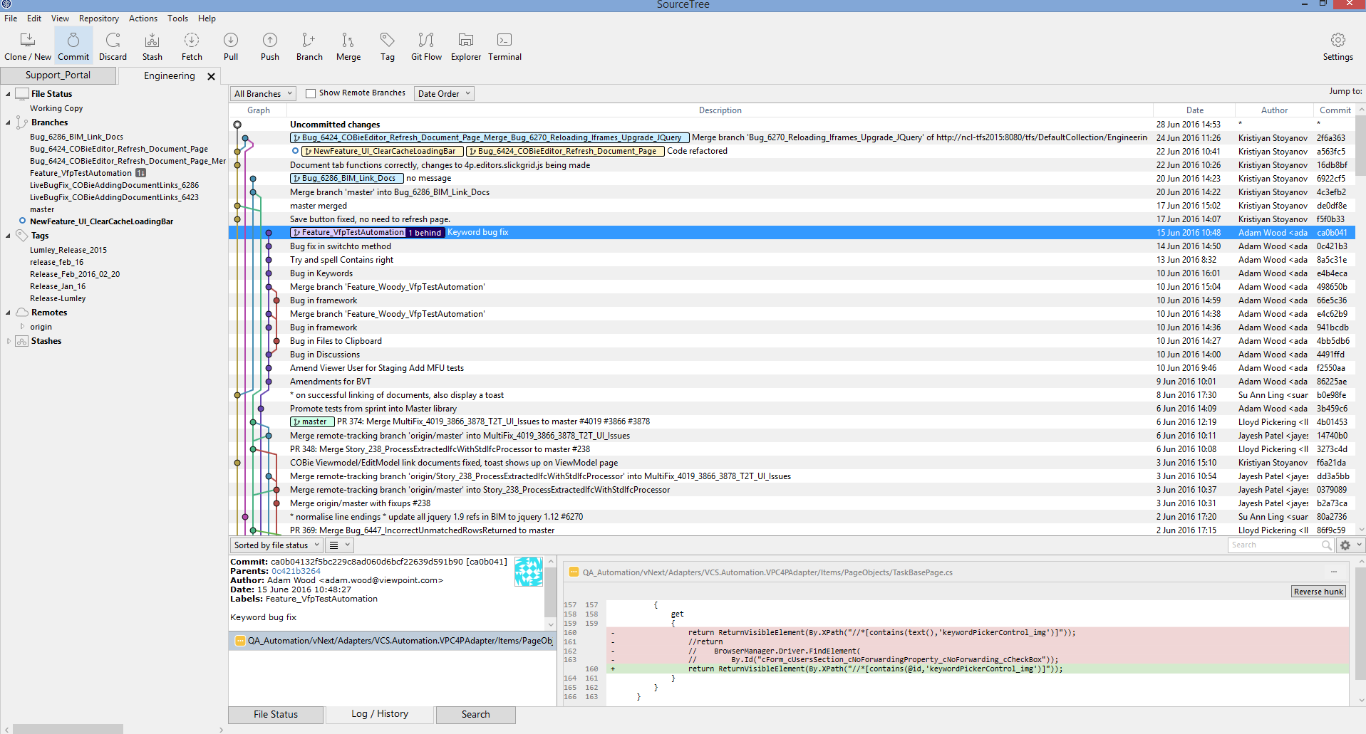
Svcs – bim team

Slide 24
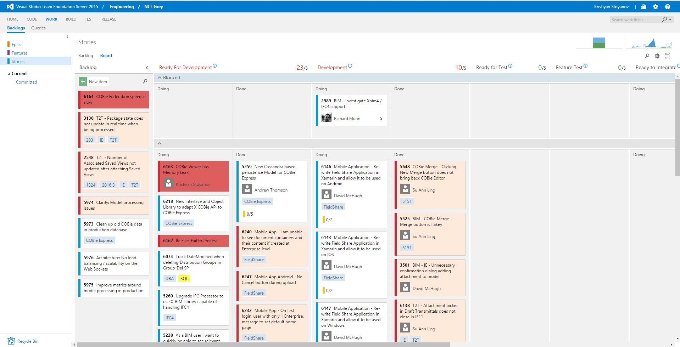
TFS KANBAN BOARD

Slide 25
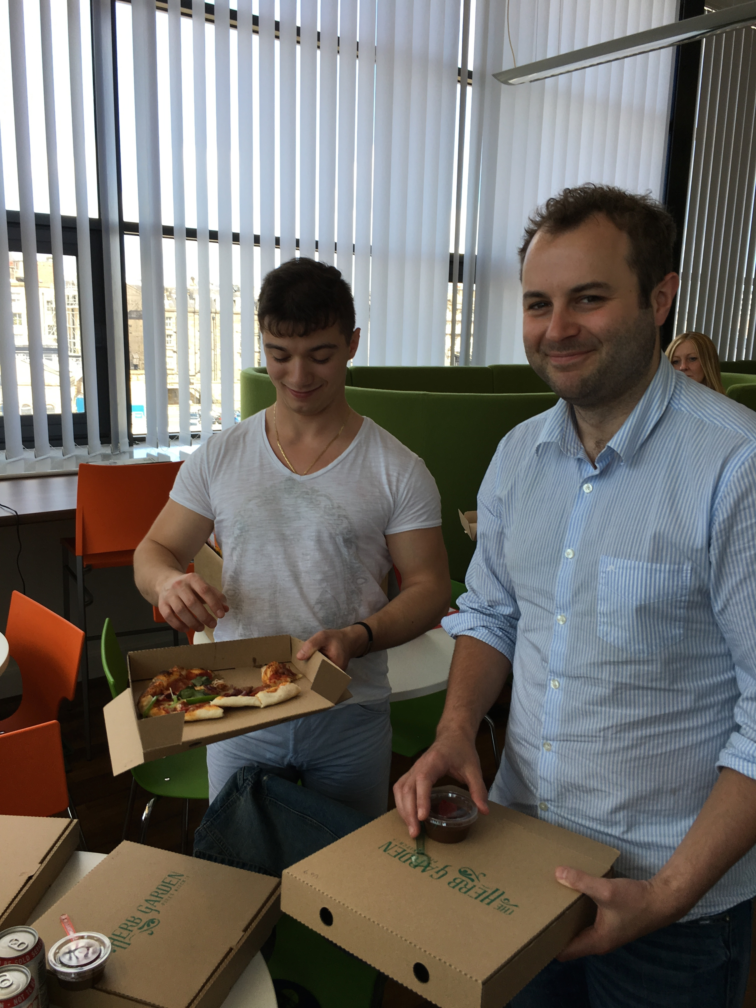
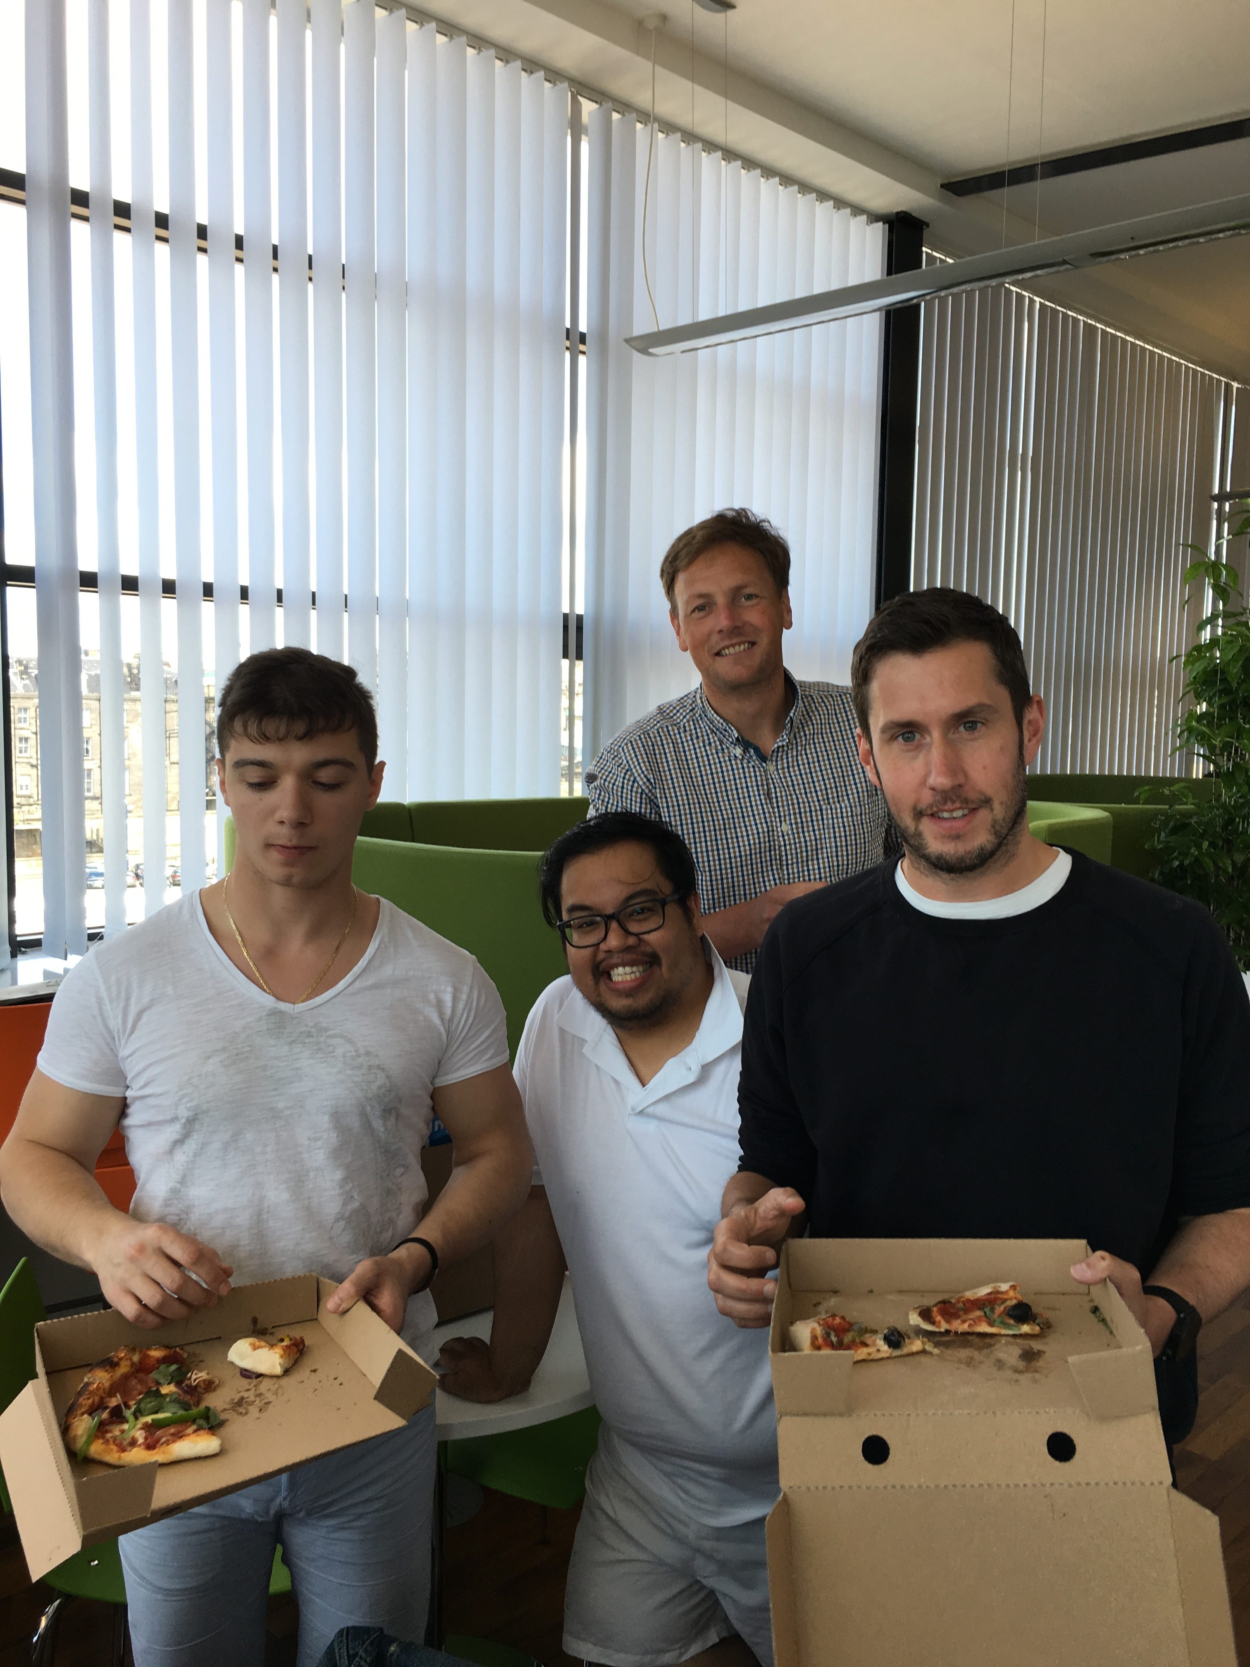
How it looked like from pictures

Slide 26
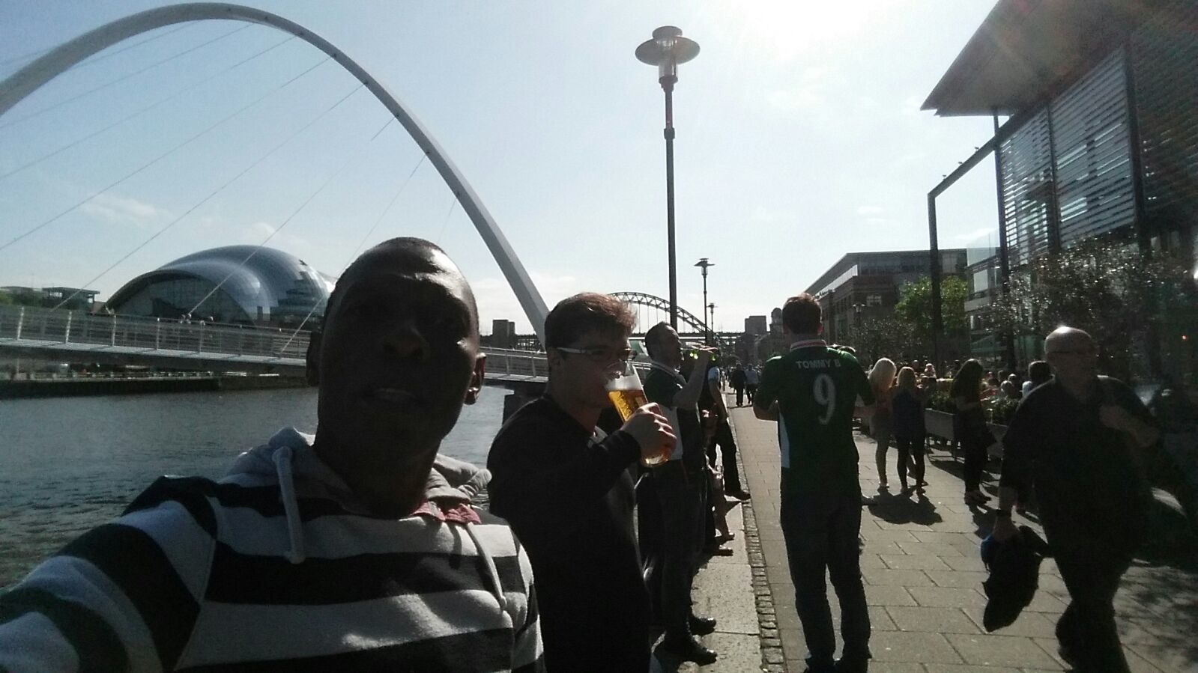
How it looked like from pictures

Slide 27
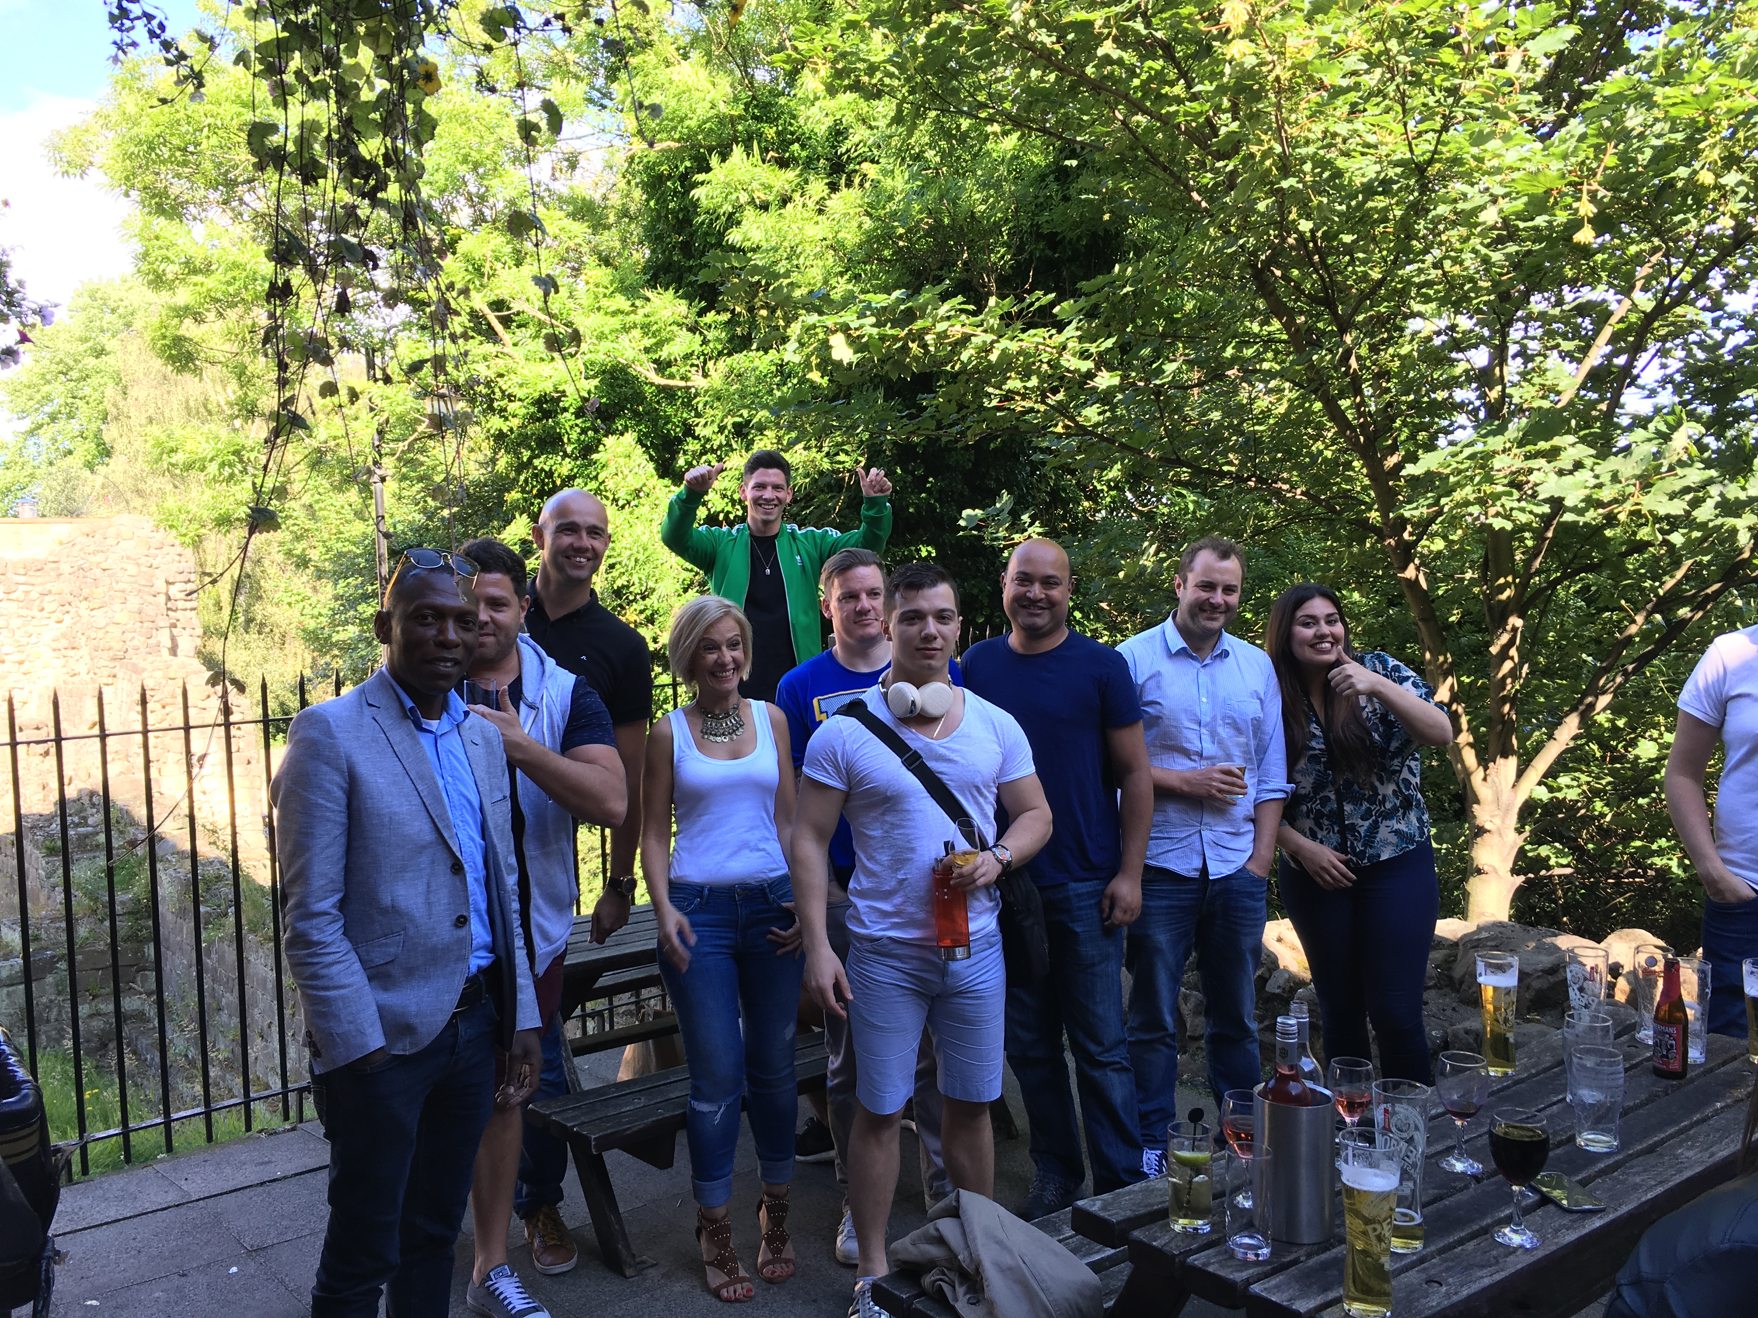
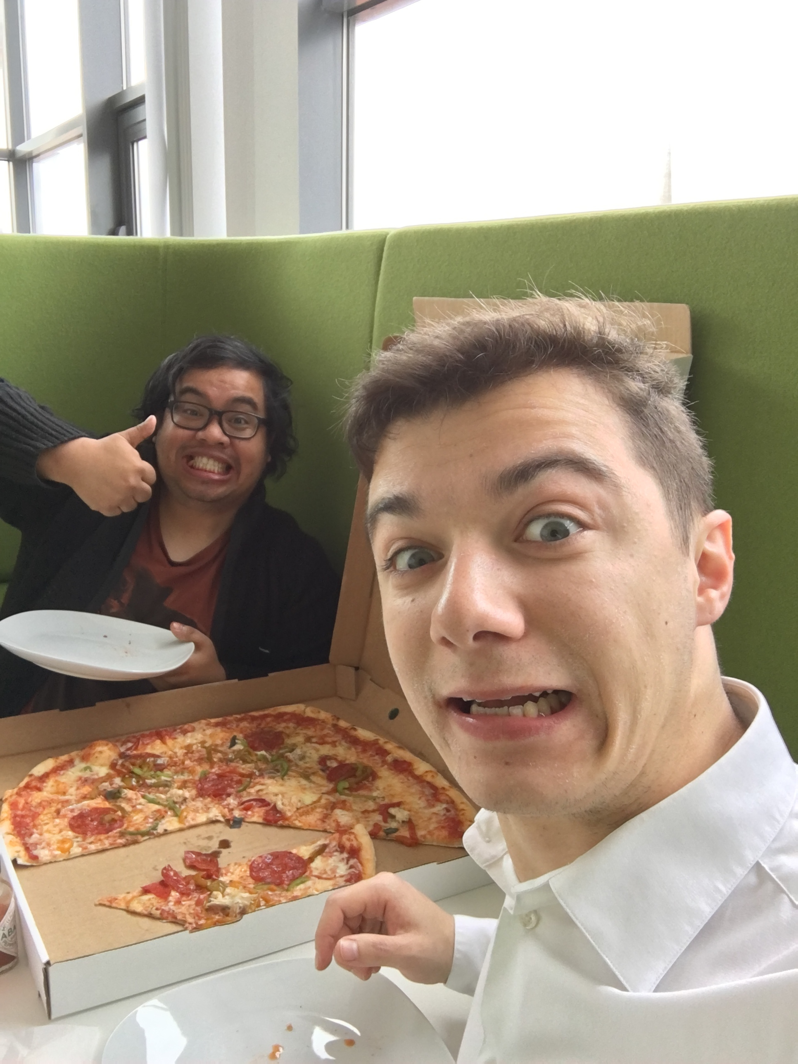
How it looked like from pictures

Slide 28
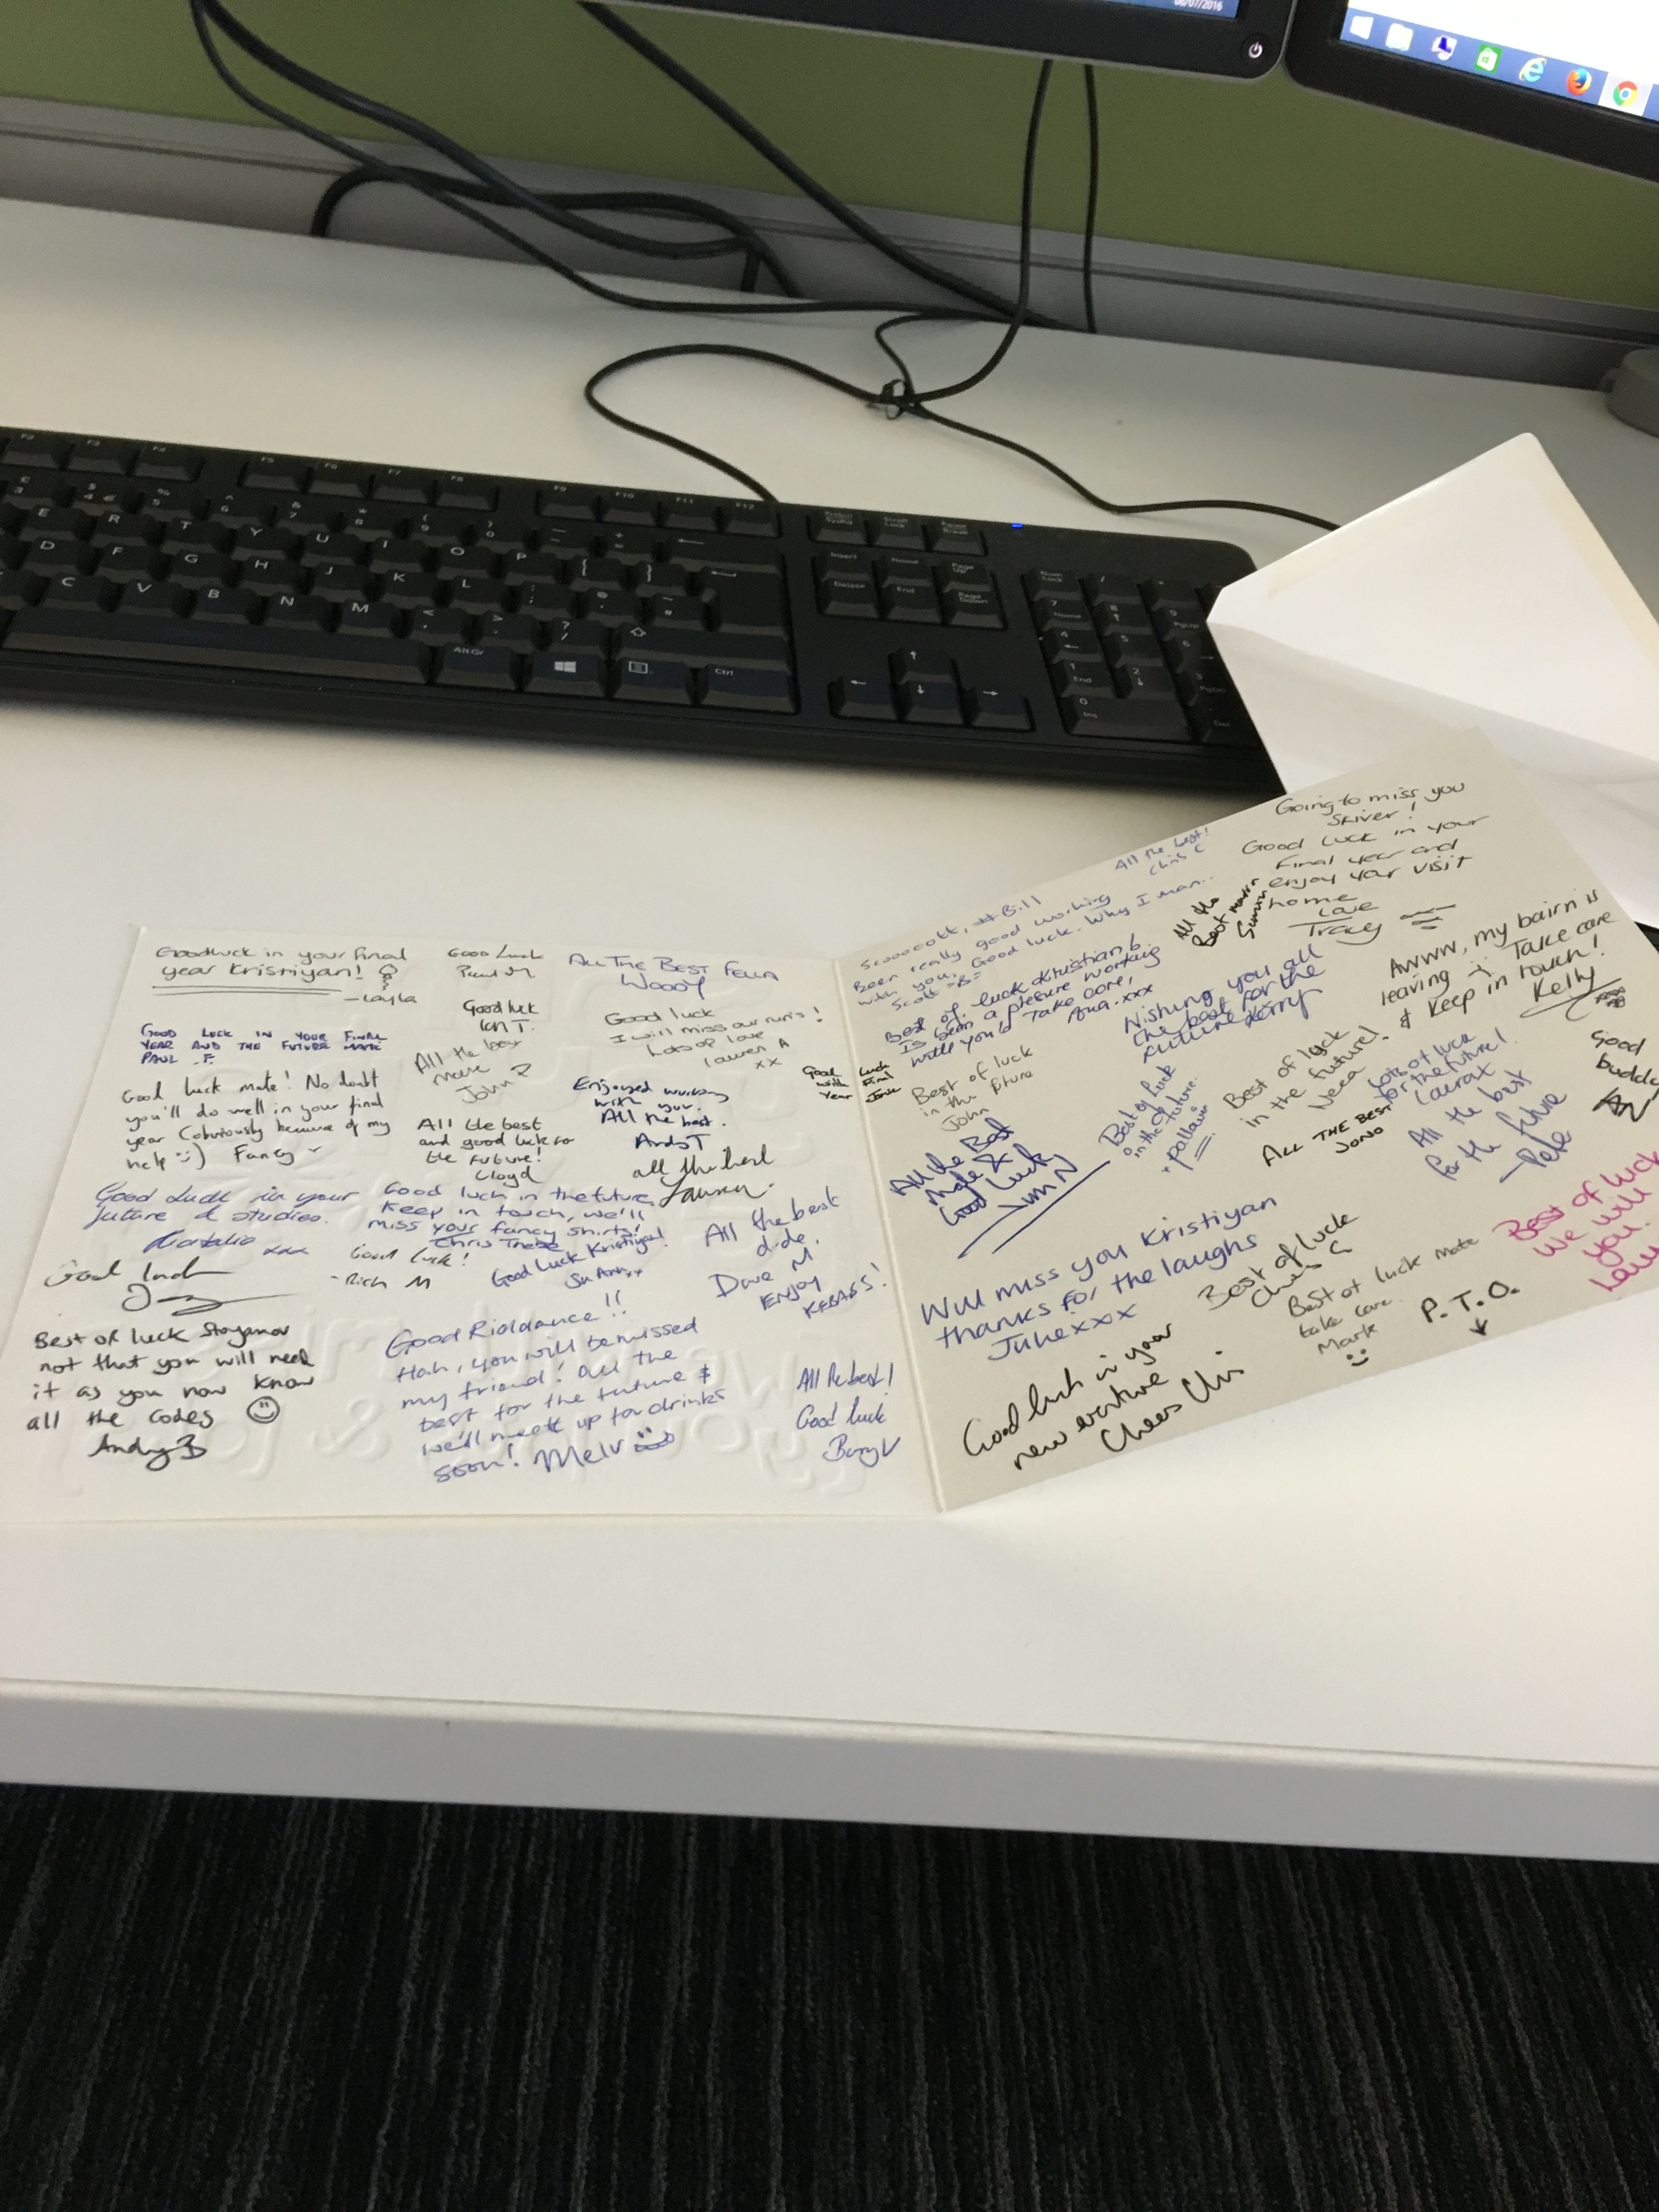
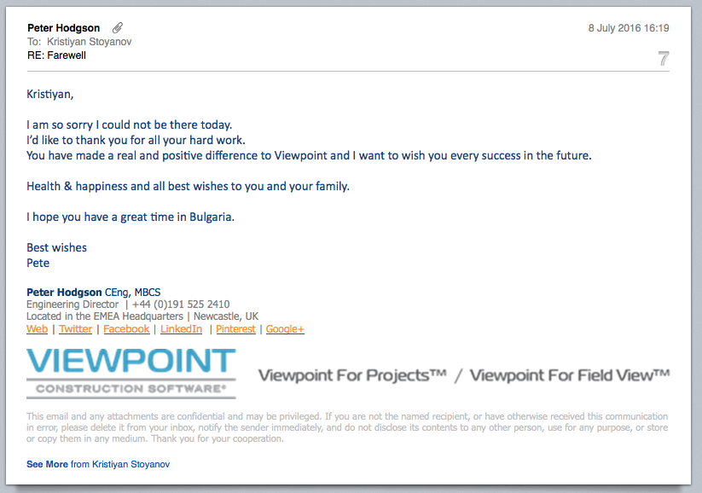
How it looked like from pictures

Slide 29
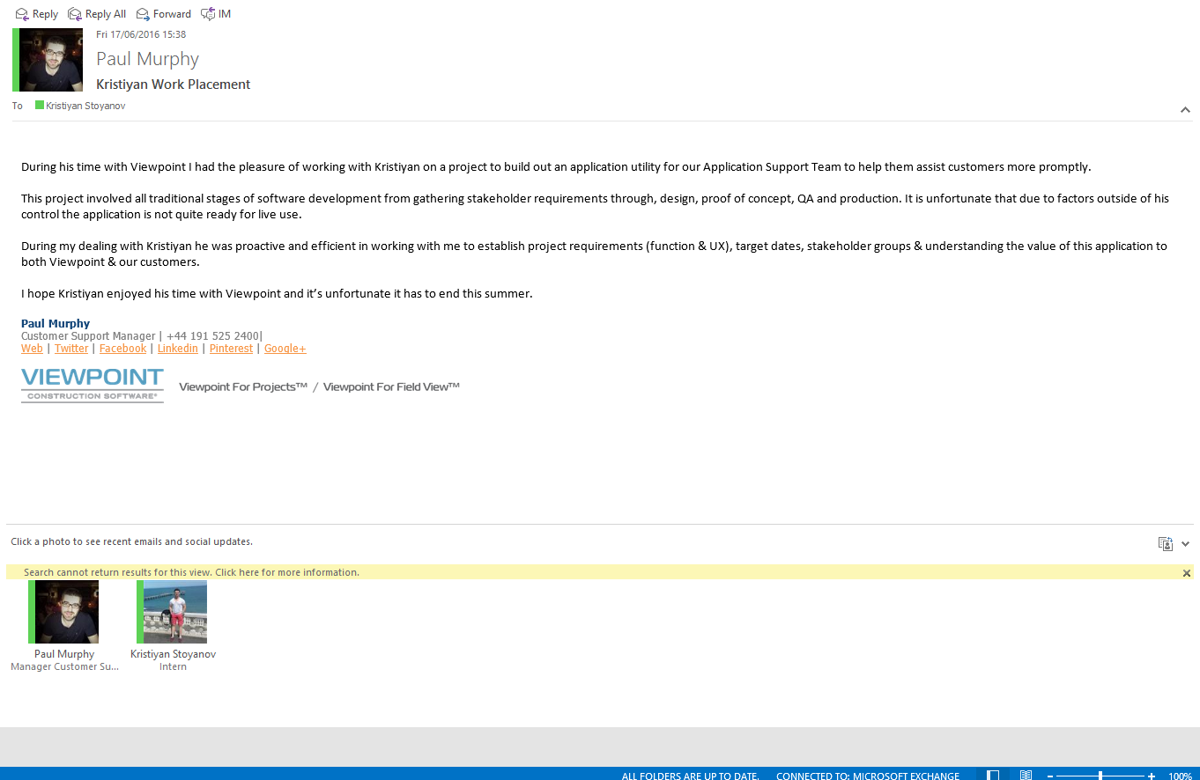
How it looked like from pictures

Slide 30

Questions

